Slide 1
Fog computing Simulation using iFogsim
Prof. Yen-Wen Chen
Student Tsu-Chi Chen

Slide 2
Outline:
Introduction
Case study
Result
Notes:
使用實例的決策管理

Slide 3
Introduction

Slide 4
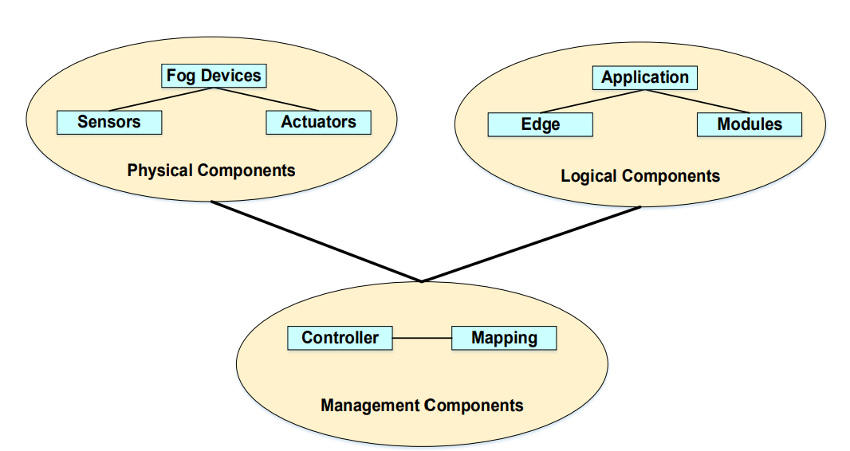
Introduction
iFogsim is a high-performance open source toolkit for fog computing, edge computing and IOT
It enables modeling and simulation of Fog Computing Environment for evaluation of resource management latency and delay
Notes:
在模擬結束後會收集相關的result並解呈現

Slide 5
Introduction
These are the classes of iFogSim that are required to simulate the fog network
Fog device
Sensor
Actuator
Monitoring components
Resource management service

Slide 6
iFogsim
Physical Components
The lower level Fog devices are directly connected with associated sensors and actuators
The sensors in iFogSim generates tuples that can be referred as tasks in Cloud computing.
Logical Components
the AppModules can be mapped with Virtual Machines (VMs) and the AppEdges are the logical dataflow between two VMs
Notes:
執行器
AppModule會接收tuple處以後，再產生另一種tuple 送往下個目的地
AppEdge 是代表兩個裝置之間可以送多少的資料量

Slide 7
Case study
the Intelligent Surveillance application has been evaluated on a number of physical infrastructure configurations.
Each consist 1,2,4,8,16 surveilled area and each connected to 4 monitors
Each surveilled area has 4 smart cameras monitoring the area.
Notes:
監視區域

Slide 8
Low-latency communication：
the Pan-tilt-zoom (PTZ) parameters of multiple cameras need to be tuned in real-time on the basis of the captured image.
Handling voluminous data：
Video cameras continuously send captured video frames for processing, which causes a huge traffic.
Heavy long-term processing：
The camera control strategy needs to be updated constantly so that it learns the optimal PTZ parameter calculation strategy.
This requires analysis of the decisions taken by the control strategy over a long period, which makes this analysis computationally intensive.
Notes:
這需要低的延遲才辦的到
平移–傾斜–縮放
考慮到所有的camera所錄製的影片，會導致大量的串流資料，所以需要處理一些這些大量的資料而不造成壅塞

Slide 9
Case study
Cloud
ISP GW
Area GW
Video
PTZ_control
Video
PTZ_control
Video
PTZ_control
Video
PTZ_control
Notes:
監視區域

Slide 10
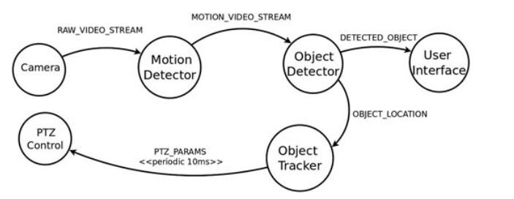
Application model of the intelligent surveillance
Notes:
the cameras that recording live video feeds act as sensors and provide input data to the application

Slide 11
Motion detection： It continuously reads the raw video streams captured by the camera to find motion of an object.
Object detection： The object detection module receives video streams in which the smart cameras detect motion of an object.
Notes:
1.把video stream送給object detection做處理，這個是在camera裡面的
2.如果這個object沒有出現在畫面過，他就會追蹤這個object，並記錄座標
The module extracts the moving object from the video streams and compares them with previously discovered objects, which are active in the area currently.

Slide 12
Object tracker：The object tracker module receives the last calculated coordinates of the currently tracked objects and calculates an optimal PTZ configuration of all the cameras covering the area
PTZ control： This module adjusts the physical camera to conform to the optimal PTZ parameters sent by the object tracker module.
Notes:
他會收到對應的座標然後計算出最好的PTZ參數並回傳
PTZ調整的參數，會週期性的傳給camera
PTZcontrol在camera裡面

Slide 13
Source | Destination | Latency,ms
Camera | Area Gateway | 2
Area Gateway | ISP Gateway | 2
ISP Gateway | Cloud data center | 100
Description of inter-module edges in the Intelligent Surveillance application
tuple processing requirements | Network Transmission rate | Average interarrival time
500 M instruction | 20 000 bytes per second | 5 ms
Configuration of camera for Intelligent Surveillance
Device type | 處理速度(MIPS)
Cloud data center | 44800
Area gateway | 2800
Notes:
bps

Slide 14
Result
Notes:
基於使用案例決策考量

Slide 15
Creating fog nodes
Edge-ward loop delay
Cloud only loop delay

Slide 16
Average latency
Notes:
這張圖可以說明，tuple傳輸越多，就會造成更大的延遲，而使用fog computing就不會隨著網路拓樸變大，而影響lantancy

Slide 17
Network usage
Notes:
網路流量
因為是使用高latency的通道，所以就網路流量就比fog還要低

